Slide 1

Robot Presentation
By: Dennis Vaccaro, Chalen Bobish, Jack Staker

Slide 2
Roles
Jack- Manager
(System Design Document, Robot Testing)
Chalen- Data/Planning
(Algorithm, Flowchart, and Robot Testing)
Dennis- Programmer
(Block Code, Test Robot, Gantt Chart, Sensor Data, Maintain Github)

Slide 3
Challenges
Coding and navigating Accuracy sprint
Losing code
Trial Documentation
Gantt Chart and SDD formatting
Finding time for us all to meet

Slide 4
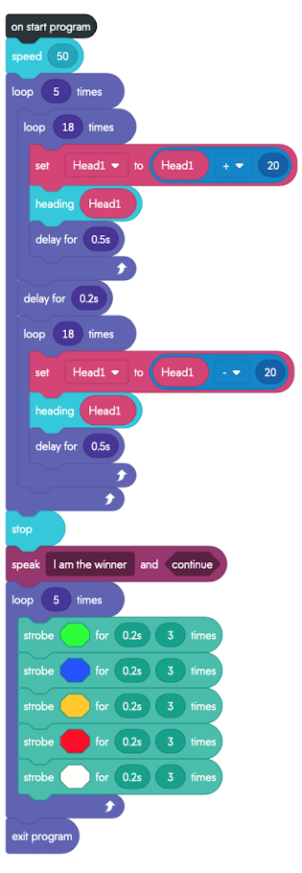
Software Engineering - Lessons learned
Application of loop sequences
Information management
Python similarities to block-code

Slide 5
What would We do Differently?
We would use the rubber cover during each of the sprints to minimize the wobble of the robot
Record every trial
Video record & written record
Charge Sphero before every class
Aim the sphero correctly every trial

Slide 6
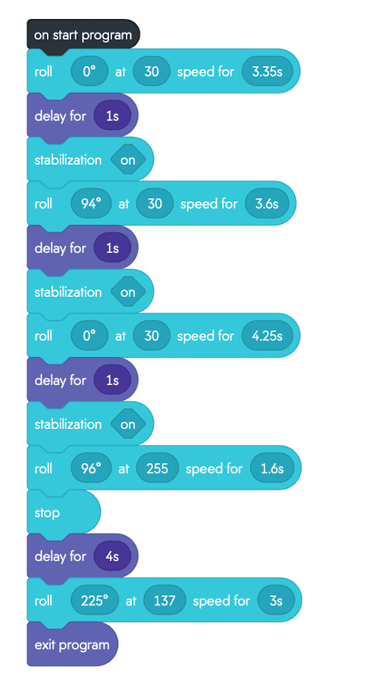
Sprint 3 Block Code:

Slide 7

Agility Video

